Slide 1
FACE RECOGNITION HOME SECURITY SYSTEM
Course No : CSE 3200
Course Title : System Development Project
Presented By: Supervised By: Sourav Mandol Dr.Sk. Mohammad Masudul Ahsan 1607044 Professor, Department of Computer Science Sumon Mia & Engineering,KUET 1607045

Slide 2
Introduction
Face recognition is a biometric technology .It goes beyond just detecting human faces in an image or video.
Our face Recognition home security system detects a face whether the guy is known or unknown , after detecting the person, it will open the GUI to open the door or unlock any security.

Slide 3
Objectives
Developing an security system based on face recognition.
Ensuring Security with user friendly interface.
Developing an IOT based project.
Detecting known faces after training the images.
Minimizing the process of retraining the machine.
To Digitalize Home and Office.
Image Acquisition.

Slide 4
Problem Statement
Identify a person’s face image from face database
Provide more security
Digitalize and more secure for their home and office.
Detecting real and fake images using liveness

Slide 5
Technical Part
Detecting faces from haarcascade method.
Recognizing faces from encodings.pickle.
Compute 128-d face embeddings to quantify a face and stored pints in encodings.pickle file
Train a Support Vector Machine (SVM) on top of the embeddings
Detecting faces’ liveness and recognizing faces in images and video streams
All of these tasks will be accomplished with OpenCV, enabling haar cascade method with integrated face_recognition_library.

Slide 6
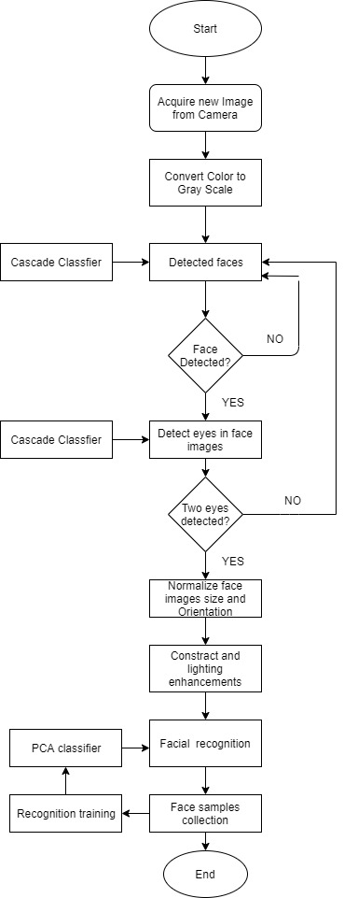
Activity Diagram

Slide 7
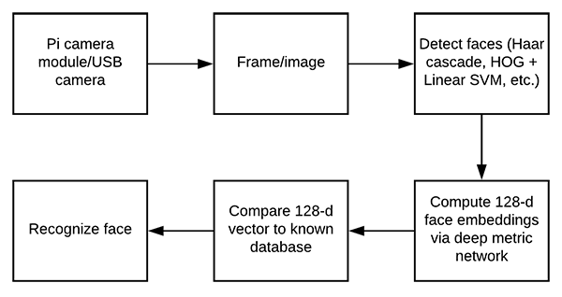
Face Recognition Embedding

Slide 8
Overview
Face Recognition Home Security System basically has some modules for proper functioning
Admin - who has right for
creating space for new members
rename member
remove member
change password.
Members and strangers can observe them as the are known or not.
For new user, system have some instructions in help section.

Slide 9
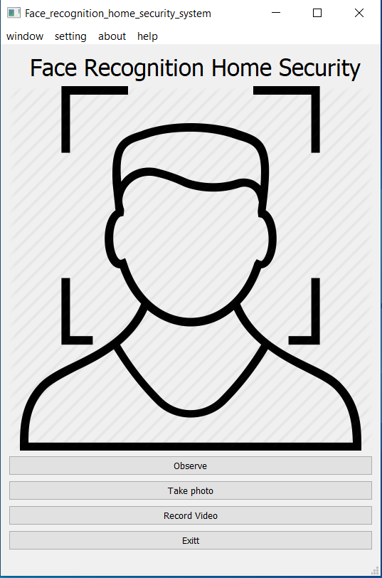

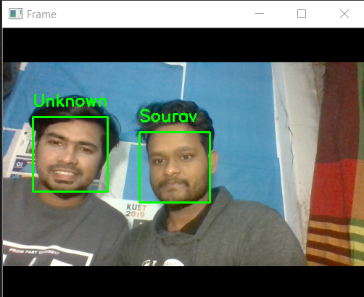
Graphical User Interface
User have to go home window to security panel by clicking security from window navigation section or click Ctrl+S.

Slide 10


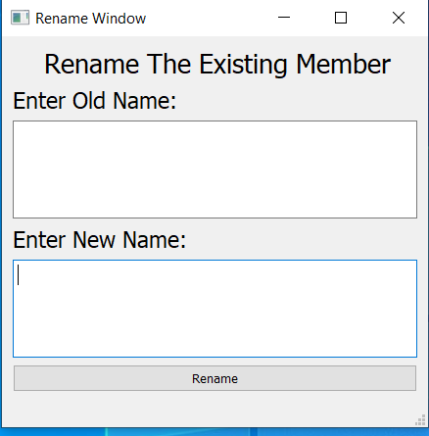
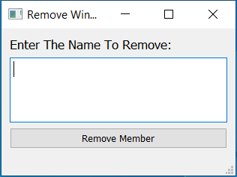
Graphical-User-Interface User have to go home window to admin panel by clicking security from window navigation section or click Ctrl+A.Admin can add member, remove member and rename member.

Slide 11
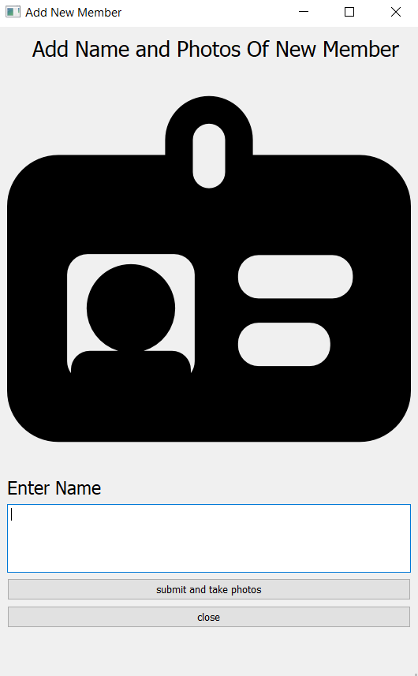
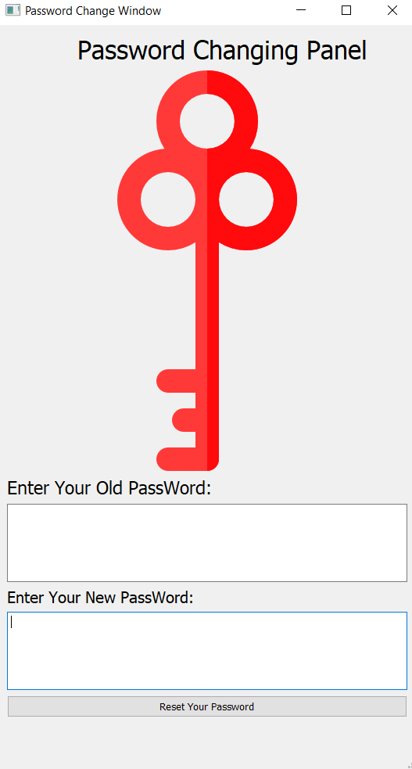
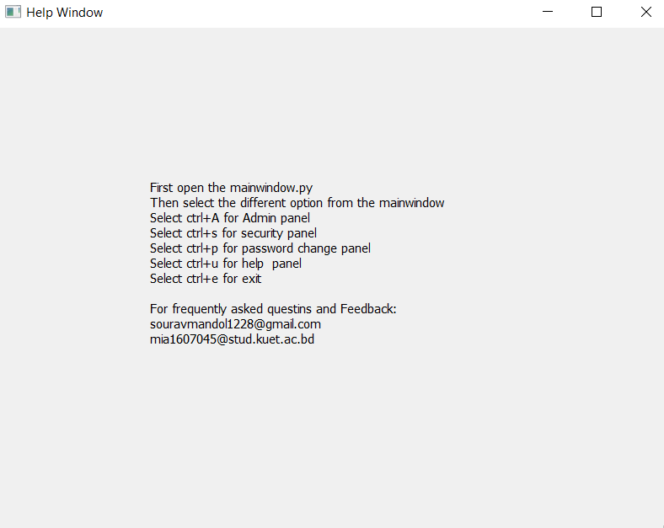
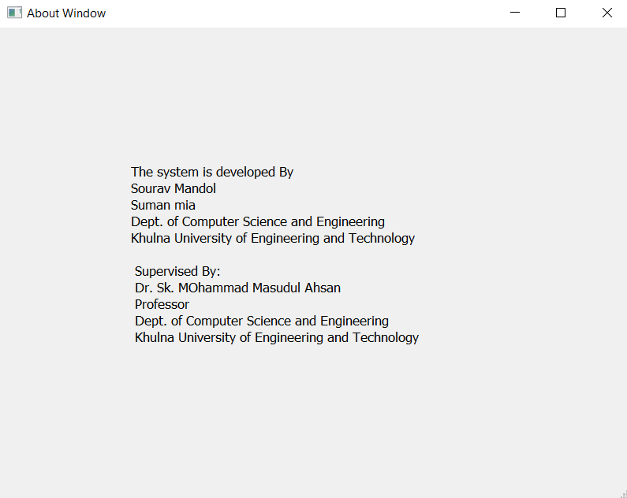
Graphical User Interface Users can change his/her password and system provide help and about section for some instructions and helps for user.

Slide 12
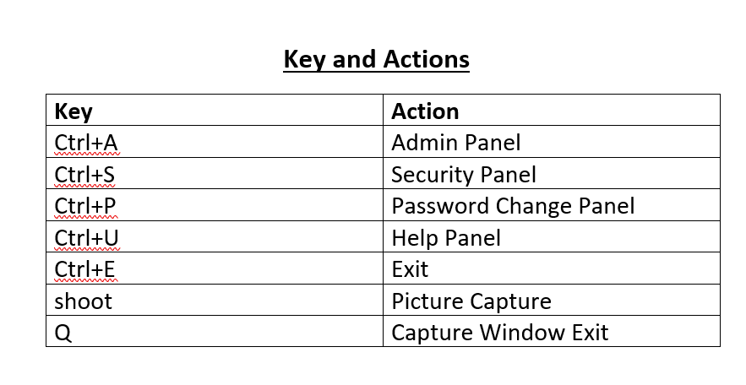
Key and Actions

Slide 13




Features
User Friendly
Digitalize Home
High Accuracy Rates and Faster Processing
Reponse are easily generated

Slide 14
Challenges faced
The designed algorithm was effectively able to detect the different type of faces specified on this project and recognize those faces which are known or unknown.
The system is able to detect an object in both high and low light.
The system has more efficiency because it detects a customer within six (6) images putting on the dataset.
Its accuracy is almost 90%. If an eyeglasses person is trained in system, the system can recognize his faces.

Slide 15
Limitations
If bright light appears behind object, the system takes some times to detect it but when the system detects the faces it’s easily recognize it.
Liveness detection isn’t as strong as we want. But for average security, it works good.
A person who put eyeglass in front camera but who is already trained without eyeglass, the system is slow to recognize him.

Slide 16
Future Development
In future, this system will be more fast and accurate. Liveness detection will be stronger and perfectly recognize real or fake person.
Also, face will easily detect doesn’t matter the person will put eyeglasses or not in future.
In every light combination, the system is able recognize object face accurately.

Slide 17
Learning Outcomes
How to make a gui with python(pyqt5 designer)
How to detect faces from a frame
How to recognize faces from trained dataset
How to detect liveness of an image
How to make project connecting hardware and software

Slide 18
Conclusion
The Attendance Management System is developed using opencv, face recognition and deep learning fully meets the objectives of the system which it has been developed. The system has reached a steady state where all bugs have been eliminated. The system is operated at a high level of efficiency and all the user associated with the system understands its advantage. The system solves the problem. It was intended to solve as requirement specification

Slide 19
ACKNOWLEDGEMENT
We would like to express our profound and sincere gratitude to our project supervisor Dr. Sk. Masudul Ahsan, Professor of Department of Computer Science and Engineering, Khulna University of Engineering and Technology, Khulna for his rationale guideline, encouragement and for taking time off his busy schedule to provide invaluable input to words to complete our project. His suggestion and encouragement play a vital role in our project work.

Slide 20
THANK YOU

